Slide 1
Introduction to Linux
Francisco Fuster Tormo
13 - 03 - 18
ffuster@carrerasresearch.org

Slide 2
What is Linux?
Operating System (OS) based on UNIX
What is UNIX?
OS …
Other UNIX-based OS?
Mac OS
Android

Slide 3
How many Linux are?
Debian
Ubuntu
Linux Mint
Red Had
Fedora
OpenSuse
CentOS
Mandrake
...

Slide 4
Is Linux difficult to use?
Graphic User Interface

Slide 5
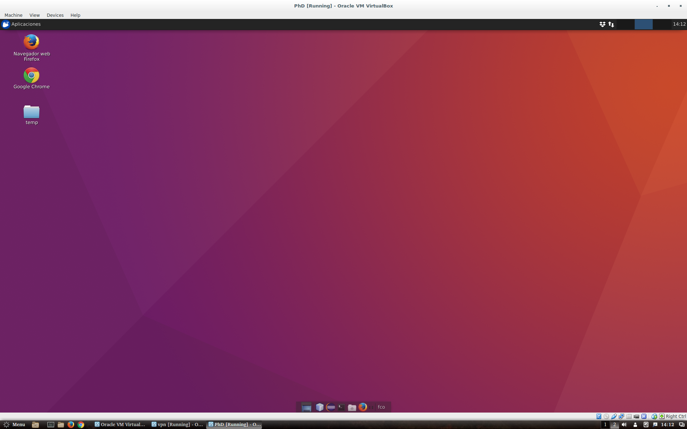
Is Linux difficult to use?
Graphic User Interface

Slide 6
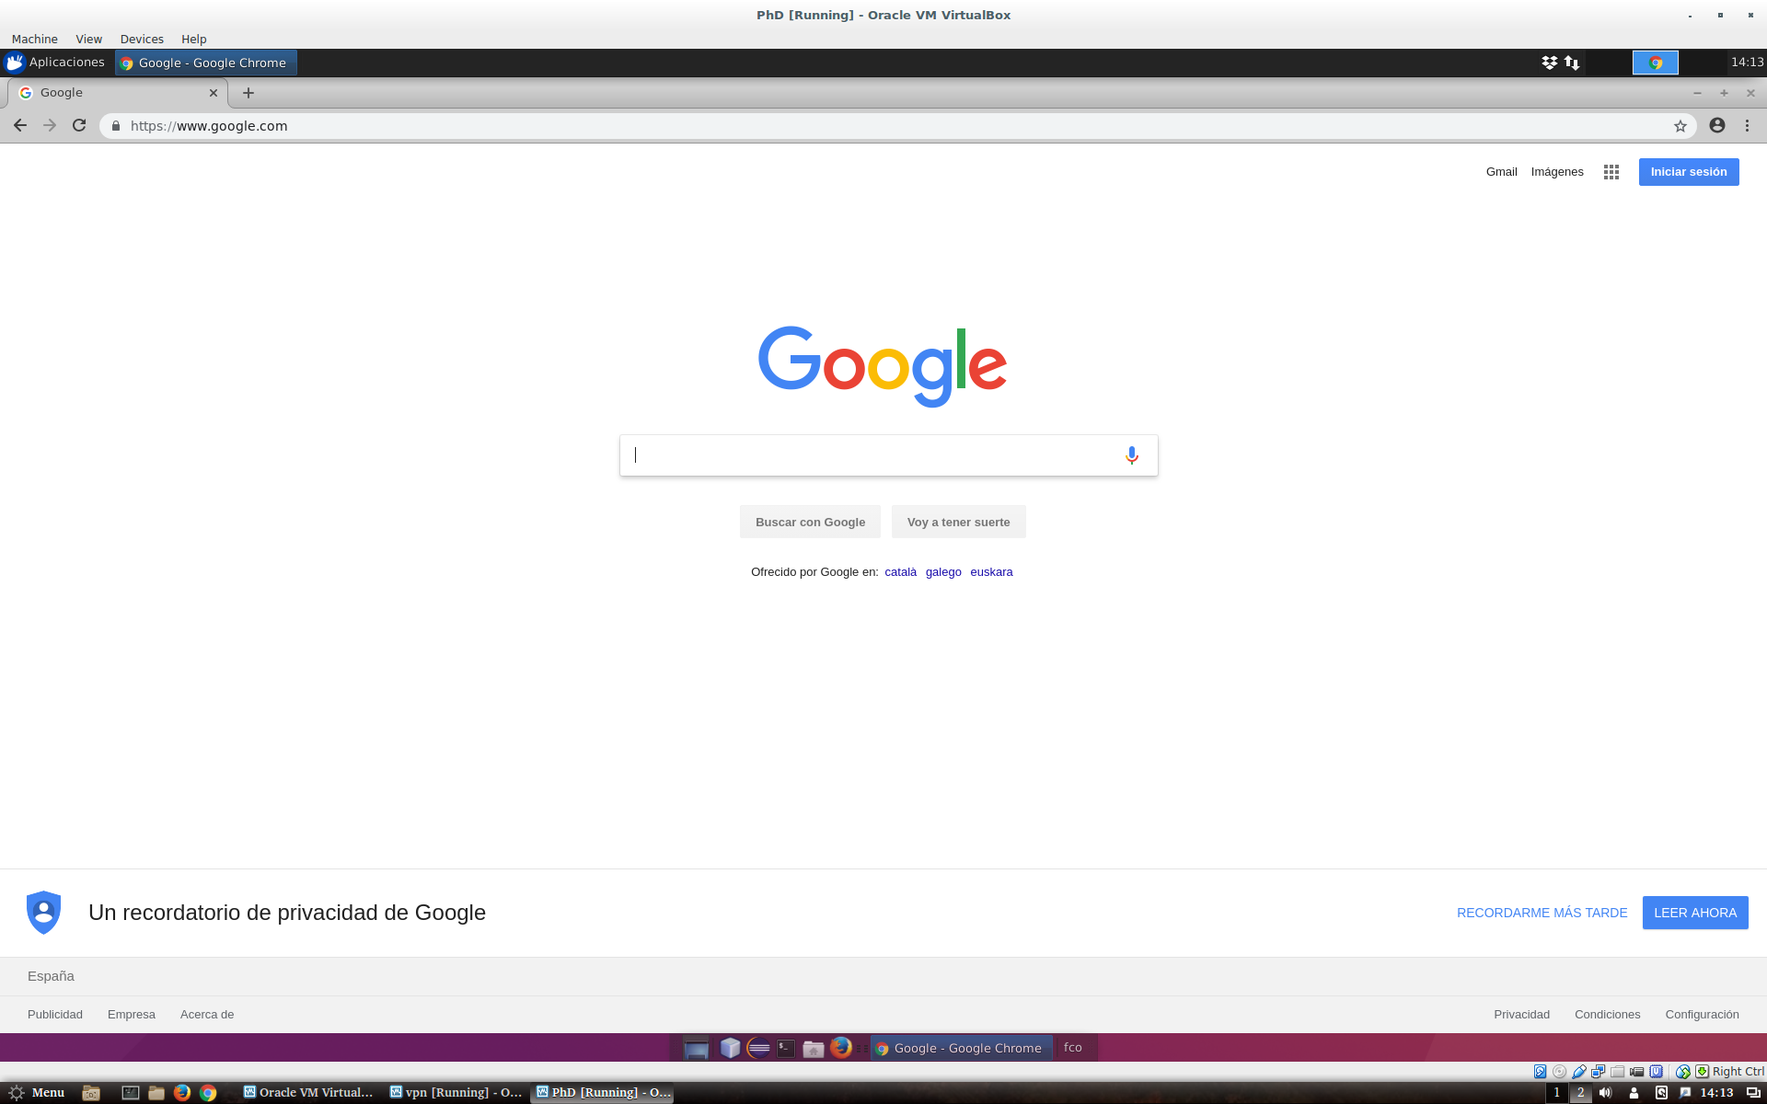
Is Linux difficult to use?
Graphic User Interface

Slide 7
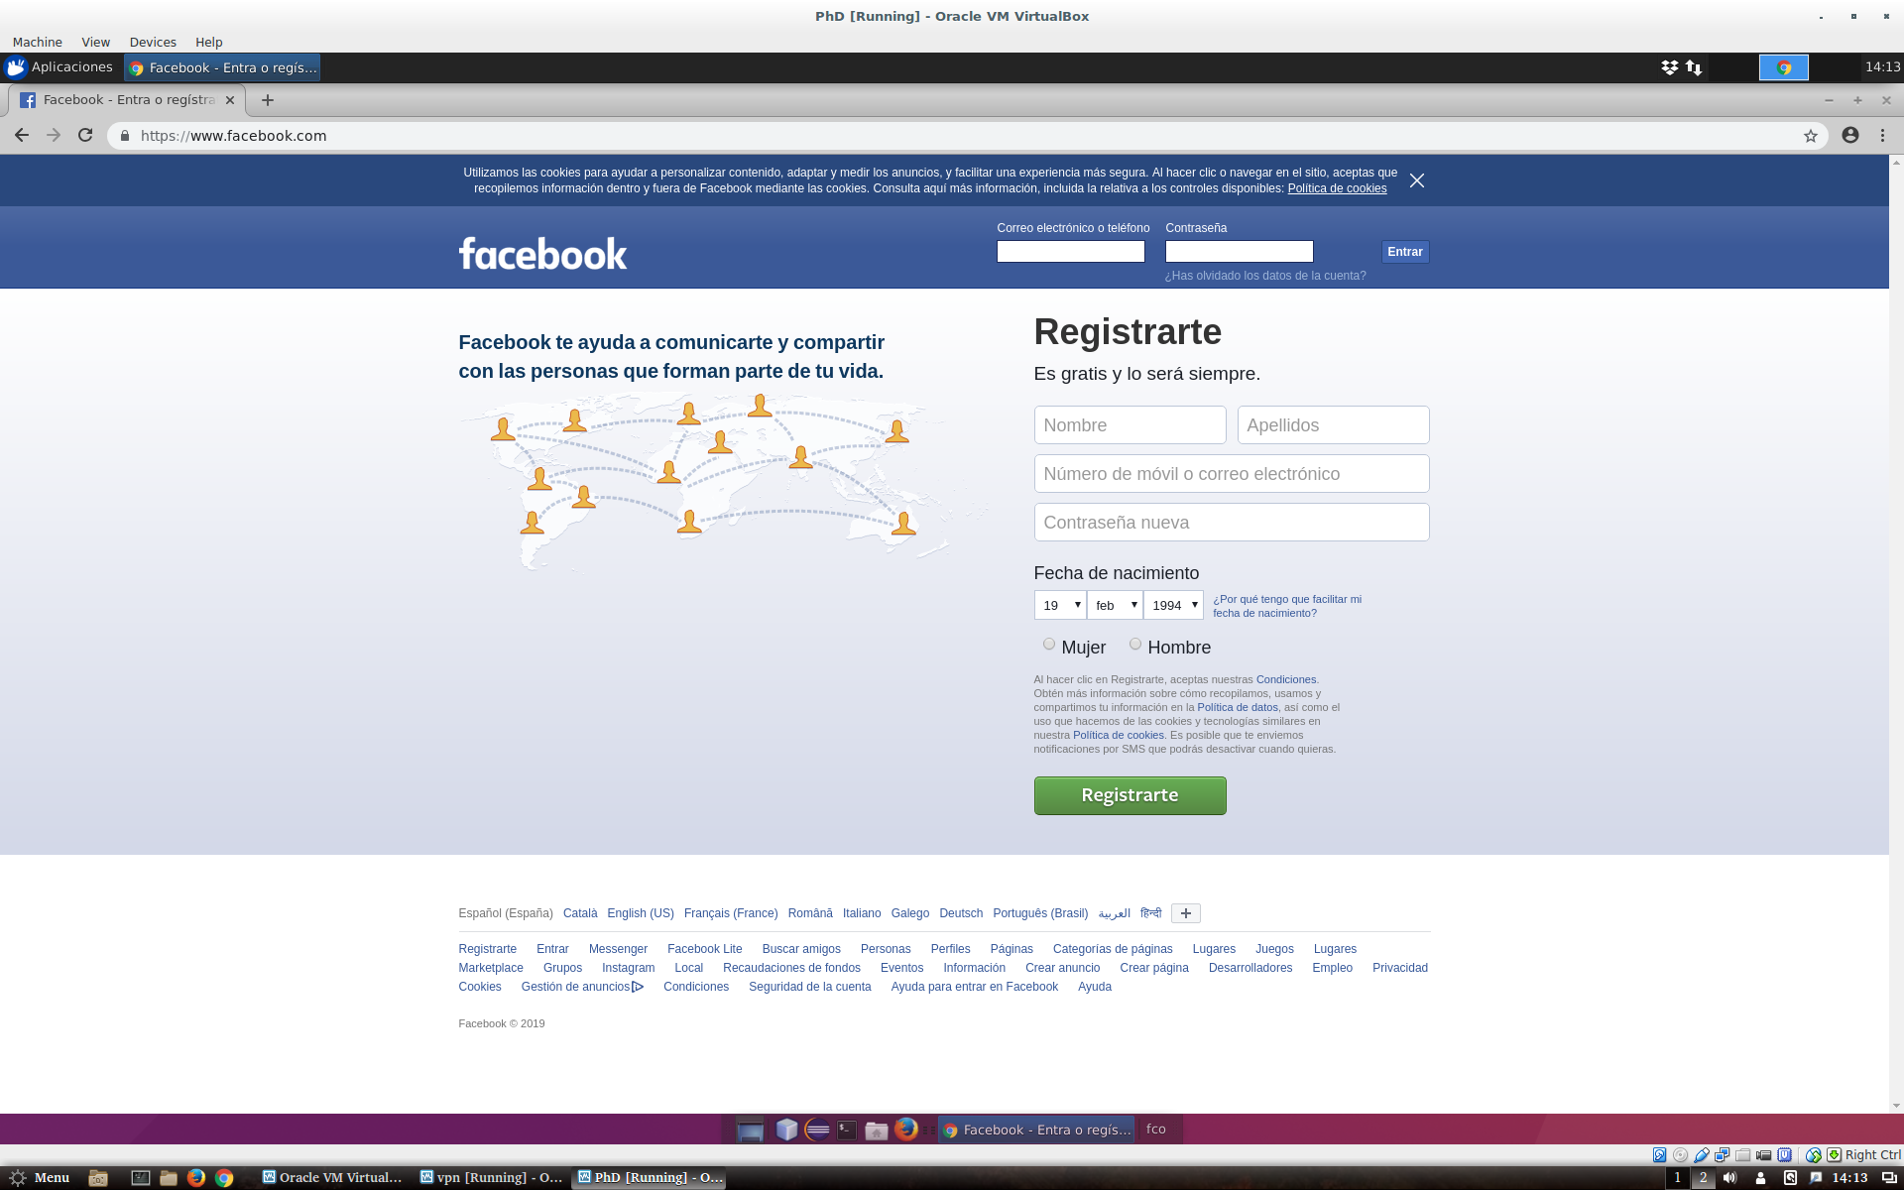
Is Linux difficult to use?
Graphic User Interface

Slide 8
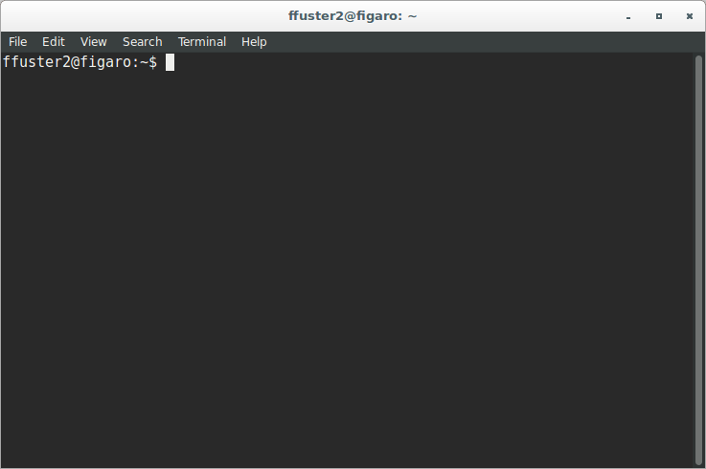
But...

Slide 9
Differences between Windows & UNIX
TODO fotos de la consola

Slide 10
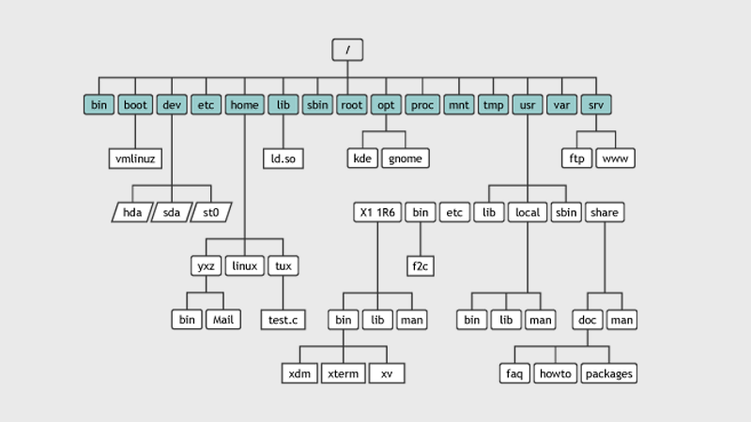
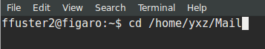
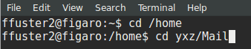
The Linux filesystem

Slide 11
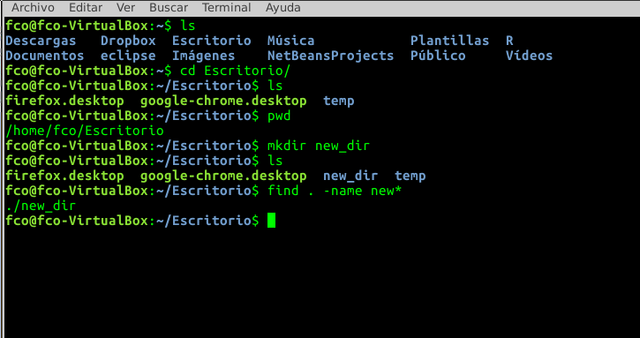
Linux basic commands (1). Folder navigation
cd → Navigation in directories
ls → List the files/directories in a path
pwd → Get absolute path of current directory
mkdir [folder_name] → creates the folder [folder_name] in the current path
find [pattern] → Searches files in the specified position

Slide 12
Exercise (1)
Go to your home folder /home/user
Create the directory ‘course’ in you home folder
List all the elements you have in your home folder
Get absolute path of your folder

Slide 13
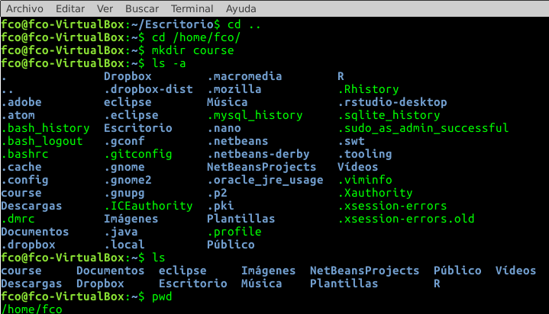
Exercise (1)
Go to your home folder
Create the directory ‘course’ in you home folder
List all the elements you have in your folder
Get absolute path of your folder

Slide 14
Linux basic commands (2). Copy, move, remove files
touch [file_name] → creates an empty file called [file_name]
cp [file_origin] [file_destination] → copy [file_origin] in [file_destination]
rsync [origin_folder] [destination_folder] → Synchronize both folders
mv [file_origin] [file_destination] → move [file_origin] to [file_destination]
rm [file] → removes [file]

Slide 15
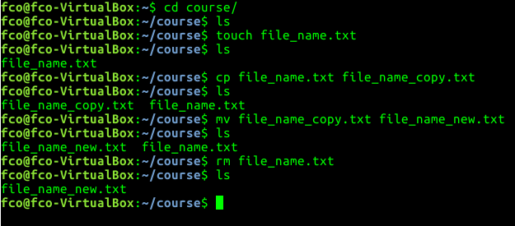
Linux basic commands (2). Copy, move, remove files
touch [file_name] → creates an empty file called [file_name]
cp [file_origin] [file_destination] → copy [file_origin] in [file_destination]
rsync [origin_folder] [destination_folder] → Synchronize both folders
mv [file_origin] [file_destination] → move [file_origin] to [file_destination]
rm [file] → removes [file]

Slide 16
Exercise (2)
Create a new file called ex2.sh in your home folder
Copy this file to your recently created folder
Remove the file from your home folder

Slide 17
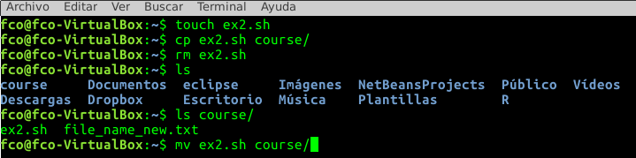
Exercise (2)
Create a new file called ex2.sh in your home folder
Copy this file to your recently created folder
Remove the file from your home folder

Slide 18
Exercise (2)
Create a new file called ex2.sh in your home folder
Copy this file to your recently created folder
Remove the file from your home folder

Slide 19
Linux commands (3). Working with files
head -n [number_of_lines] [file]→ Show first [number_of_lines] of the [file]
tail -n [number_of_lines] [file] → Show last [number_of_lines] of the [file]
cat [file] → Print all the file
less [fille] → Print all the file
grep [word] [file] → Find [word] in [file]
cut -f [columns] [file] → Show only [columns] of [file]
sort -k [column] [file]→ Sort the lines of a file by [column]
diff [file1] [file2] → Compare [file1] and [file2] line by line
uniq [file] → Report or omit repeated lines in file
tr → Translate or delete characters

Slide 20
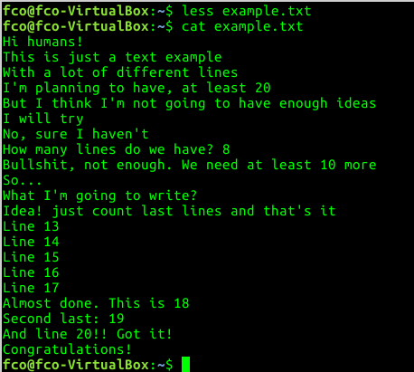
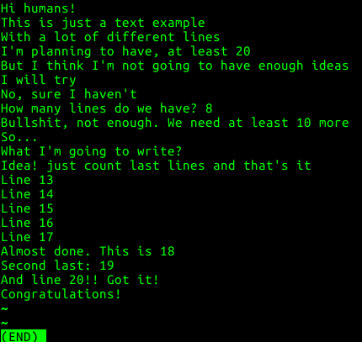
Examples (2)
cat & less

Slide 21
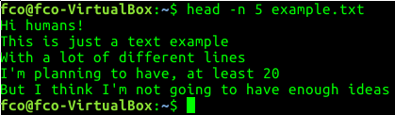
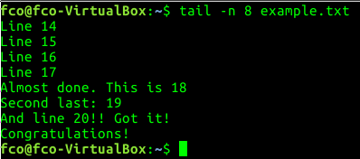
Examples
head & tail

Slide 22
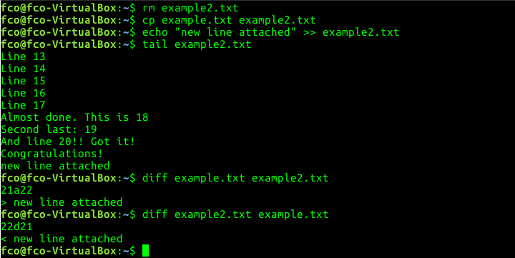
Examples (3)
diff

Slide 23
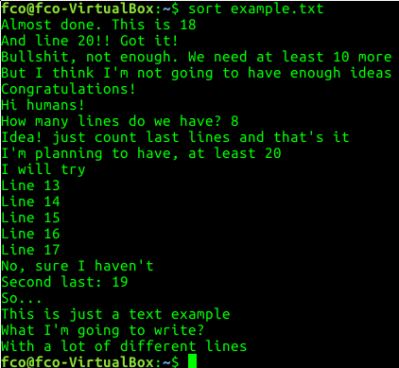
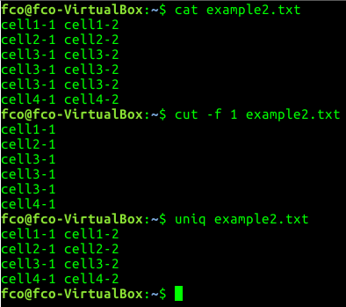
Examples (4)
sort, uniq & cut

Slide 24
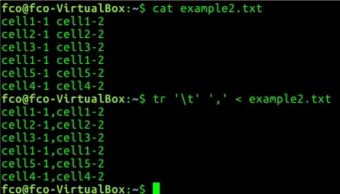
Examples (5)
tr

Slide 25
Exercise (3)
Copy exercise.tsv in course folder
Print last 10 lines of the file
Print 6th column of the file
Convert all the ‘:’ to ‘-’ in the file

Slide 26
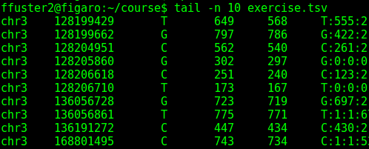
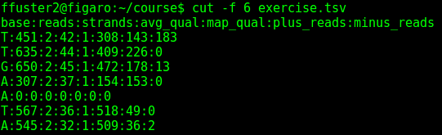
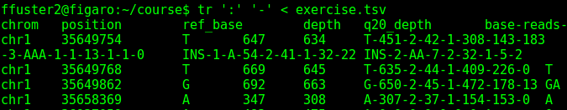
Exercise (3)
Copy exercise.tsv in course folder
Print last 10 lines of the file
Print 6th column of the file
Convert all the ‘:’ to ‘-’ in the file

Slide 27
Special characters
‘>’ [file] → Store the output in [file]
‘>>’ [file] → Append output to [file]
2> [file] → Store error output to [file]
2>> [file] → Append output error to [file]
‘<’ [file] → Use [file] as input
‘;’ → Separator between commands
‘|’ → Send the output to other program (pipe)
‘*’ → All characters

Slide 28
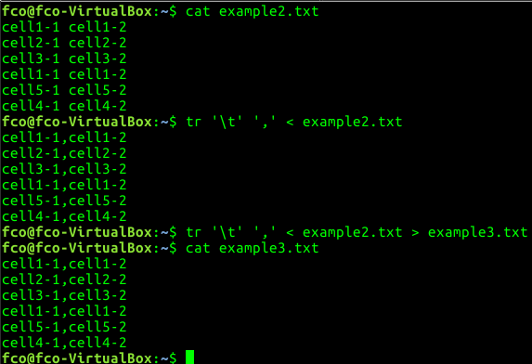
Examples

Slide 29
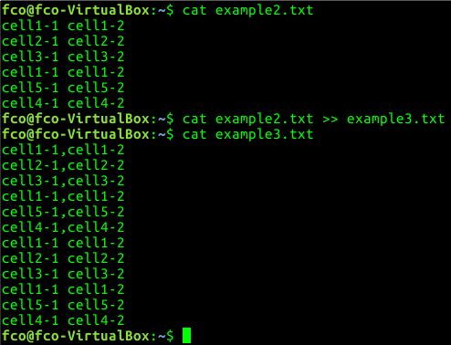
Examples

Slide 30
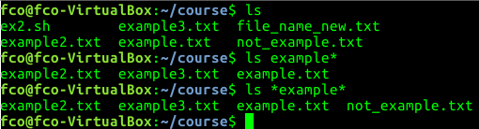
Examples

Slide 31
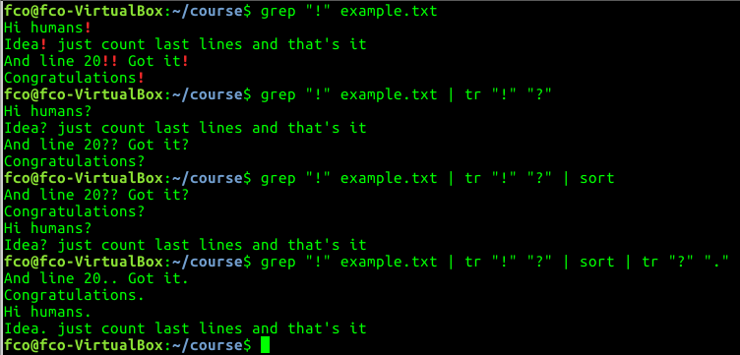
Examples

Slide 32
Exercise (4)
Print last 10 lines of exercise.tsv, but excluding last one
Print 2nd column of exercise.tsv, sort the output and store it in a new file called exercise2.tsv
Find the files in course folder that starts with ‘ex’ and has ‘2’ in the name
Print 6th column of exercise.tsv, change ‘:’ to ‘,’ and sort the output. Append the output to exercise2.tsv

Slide 33
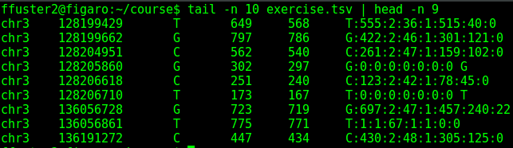
Exercise (4)
Print last 10 lines of exercise.tsv, but excluding last one
Print 2nd column of exercise.tsv, sort the output and store it in a new file called exercise2.tsv

Slide 34
Exercise (4)
Find the files in course folder that starts with ‘ex’ and has ‘2’ in the name
Print 6th column of exercise.tsv, change ‘:’ to ‘,’ and sort the output. Append the output to exercise2.tsv

Slide 35
Linux commands (4). Other useful commands
man [command] → Get the manual of [command]
wc [file] → Print newline, word, and byte counts of [file]
history → Print all the commands used
clear → “Cleans” the terminal
echo “Some words” → Prints “some words” in the terminal

Slide 36
Exercise (5)
What is the parameter in ‘wc’ command to print only the number of lines that file has?
Print all the ‘cd’ command you have used during the course

Slide 37

Exercise (5)
What is the parameter in ‘wc’ command to print only the number of lines that file has?
Print all the ‘cd’ command you have used during the course

Slide 38
Merging all
We can combine different instructions if needed

